Slide 1
4483 Capstone project presentation online Chess Analysis
Natalie Dixon-Campbell u3242089
Wednesday 4:30

Slide 2

Introduction

Slide 3

Dataset Details
Sourced from: https://www.kaggle.com/datasets/ulrikthygepedersen/online-chess-games
20 000 recorded games
Over 9000 unique players
16 columns

Slide 4
Exploratory data analysis prepa

Slide 5
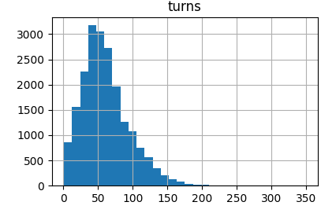
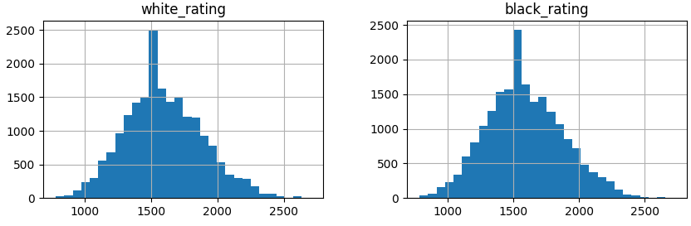
Exploratory Data Analysis Outcomes Graphs
Ratings have the expected bell curve with peak at 1500
Turns peak at 50 before tapering with a long tail till about the 200 mark.

Slide 6
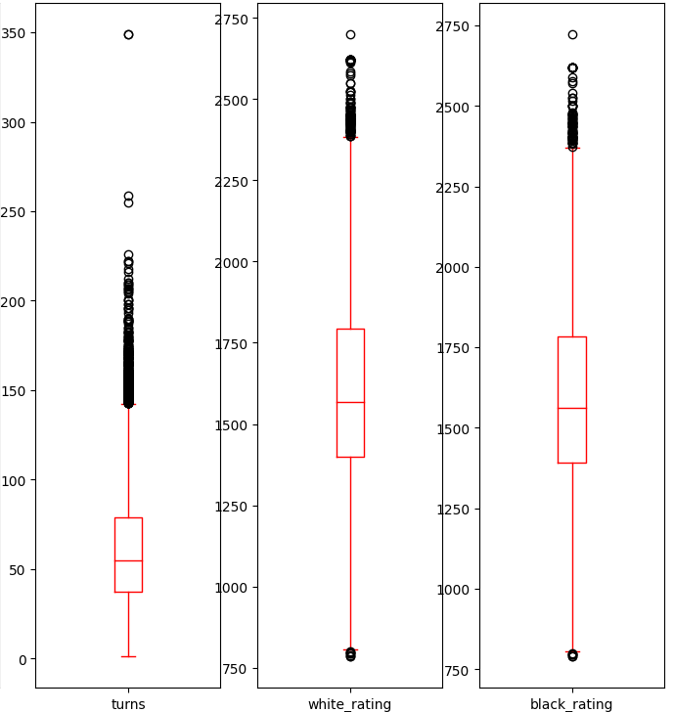
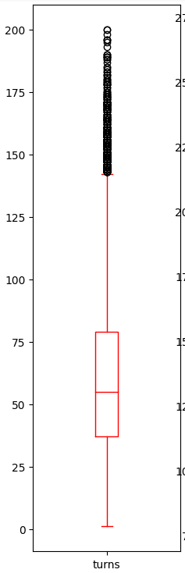
Exploratory Data Analysis Outcomes Outliers
The only outliers removed were extreme outliers in turn count
Columns dropped:
Game_id
White_id
Black_id

Slide 7
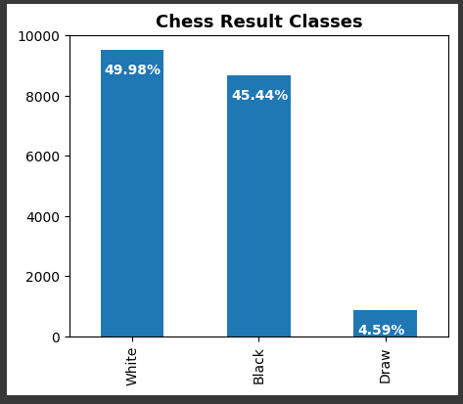
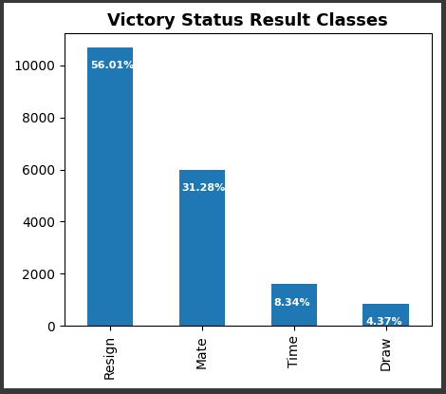
Exploratory Data Analysis Outcomes Unique Values

Slide 8
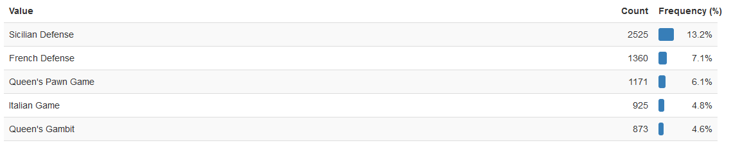
Exploratory Data Analysis outcomes Openings
5 most popular opening categories:

Slide 9
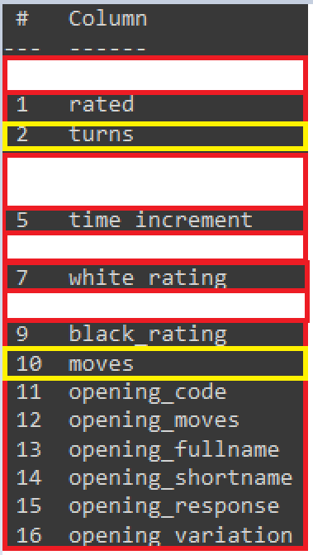
Predictive Data Analysis preparation
Two separate algorithms trained on the dataset:
One using all the data (-victory_status)
One using only data that can exist before a match starts

Slide 10
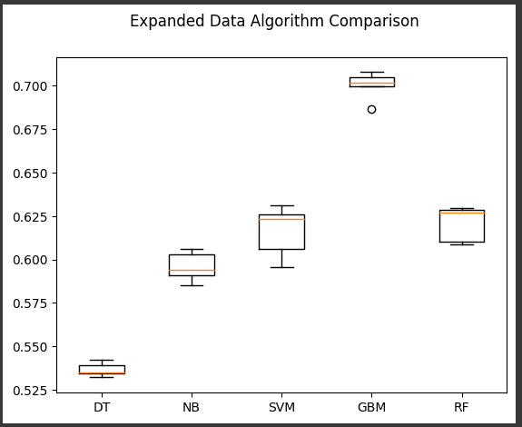
Expanded Data Algorithm Results
DT: DecisionTreeClassifier
NB: GaussianNB
SVM: SVC
GBM: GradientBoostingClassifier
RF: RandomForestClassifier

Slide 11
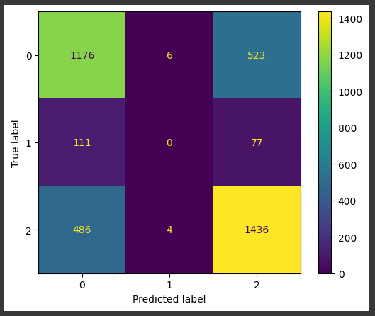
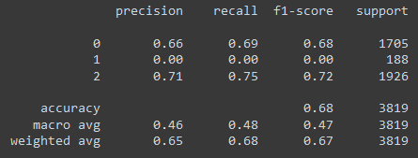
Expanded Data Algorithm Results Classification Report and Confusion Matrix
0: Black wins
1: Draw
2: White wins

Slide 12
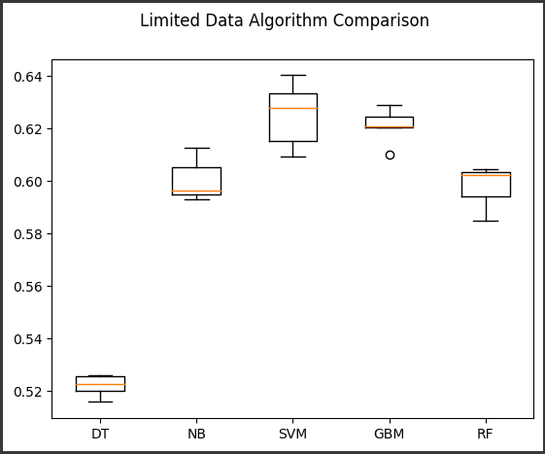
Limited Data Algorithm Results
DT: DecisionTreeClassifier
NB: GaussianNB
SVM: SVC
GBM: GradientBoostingClassifier
RF: RandomForestClassifier

Slide 13
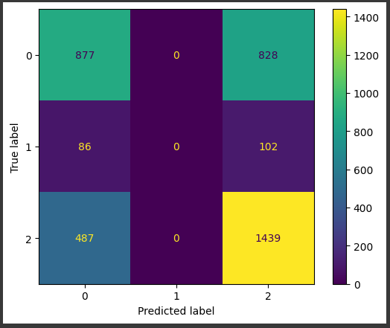
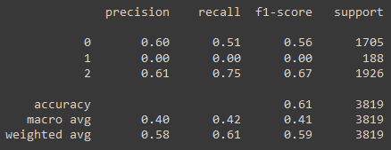
Limited Data Algorithm Results Classification Report and Confusion Matrix
0: Black wins
1: Draw
2: White wins

Slide 14
Implementation and deployment
Will use the limited data algorithm
Desktop app is mostly complete
Web platform tool is partially complete

Slide 15
References
https://www.kaggle.com/datasets/ulrikthygepedersen/online-chess-games
https://chessgrandmonkey.com/chess-rating-percentile-calculator-graph/
https://chess.stackexchange.com/questions/2506/what-is-the-average-length-of-a-game-of-chess

